Slide 1
​
Welcome to Algebra 2
Mrs. Carter's Website
Delta Math

Slide 2
Weekly Overview
Lessons
  4-3 Modeling with Quadratic Functions
  4-4 Factoring Quadratic Expressions
Activities
  Bell Work
  Notes
  Real World Applications
Assignments
  Complete & Submit Bell work
  Complete & Submit Delta Math
  Complete & Submit Enrichment
  Complete Practice Problems

Slide 3
4-3 Modeling with Quadratic Functions
Standards Objectives
A2.A.CED.A.1 Create equations and inequalities in one variable and use them to solve problems. Include equations arising from linear and quadratic functions, and simple rational and exponential functions.
A2.S.ID.B.2 Represent data on two quantitative variables on a scatter plot and describe how the variables are related. Fit a function to the data; use functions fitted to data to solve problems in the context of the data.
SWBAT create quadratic functions in one variable IOT model (fit a function to) real world data in context. (A2.A.CED.A.1, A2.S.ID.B.2)

Slide 4


4-3 Quadratic Functions and Equations
Objective
Having an $x^{2}$ term and no higher exponent
SWBAT create quadratic functions in standard form IOT model (fit a function to) real world data in context.
Provide an estimate in equation form of the relationship between two quantities.
$ax^{2}+bx+c$
As it applies to this situation

Slide 5



4-3 Modeling with Quadratic Functions
Examples
(I do) A parabola contains the points (0, 0), (-1, -2), and (1, 6). What is the equation of the parabola in standard form?
(We do) A player throws a basketball toward the hoop. The basketball follows a parabolic path through the points (2, 10), (4, 12), and (10, 12). Find a quadratic function to model this situation.

Slide 6



4-3 Modeling with Quadratic Functions
Examples
3. (They do) The table shows a meteorologist’s predicted temperatures for this particular day.
  What is a quadratic model for the data? Round coefficients to the nearest hundredth.
  Use your model to predict the high temperature for the day.

Slide 7
Independent Practice/Lesson Check 4-3

Slide 8
Independent Practice/Lesson Check 4-3

Slide 9
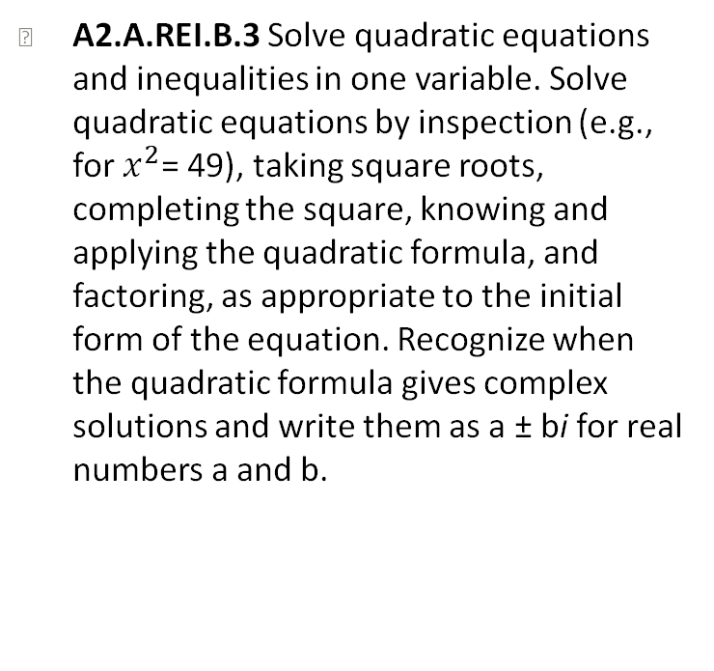
4-4 Part 1 Factoring Quadratic Expressions
Standards Objectives
A2.A.REI.B.3 Solve quadratic equations and inequalities in one variable. Solve quadratic equations by inspection (e.g., for $x^{2}$= 49), taking square roots, completing the square, knowing and applying the quadratic formula, and factoring, as appropriate to the initial form of the equation. Recognize when the quadratic formula gives complex solutions and write them as a ± bi for real numbers a and b.
SWBAT extract common and binomial factors when given quadratic expressions IOT factor quadratic expressions.

Slide 10

4-4 Factoring Quadratic Expressions
Objective
Having an $x^{2}$ term and no higher exponent
Take out
SWBAT extract common and binomial factors when given quadratic expressions IOT factor quadratic expressions.
Rewrite the expression as a product (using multiplication).
Having 2 terms
(prefix-bi)

Slide 11
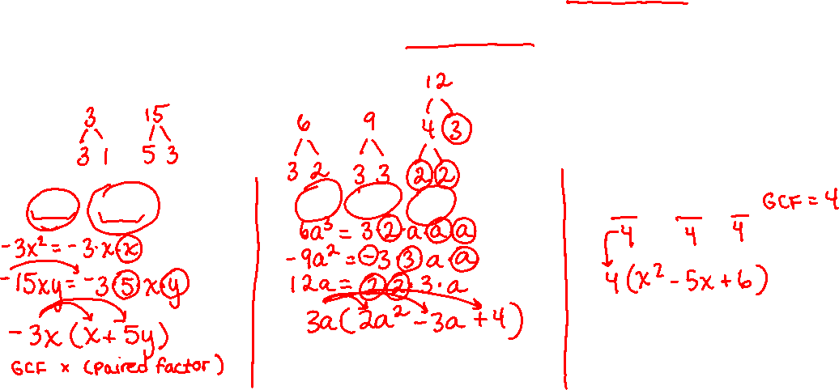
4-4 Factoring Quadratic Expressions
Key Concepts
_______________ - rewriting an expression as the product of its factors. (un-distributing)
______________________________________ – the largest quantity that is a factor of all the integers or polynomials involved.
Factoring
Greatest Common Factor
Examples
1. (I do) Factor out the GCF.
a. $−3x^{2}−15xy$ b. $6a^{3}−9a^{2}+12a$ c. $4x^{2}−20x+24$

Slide 12
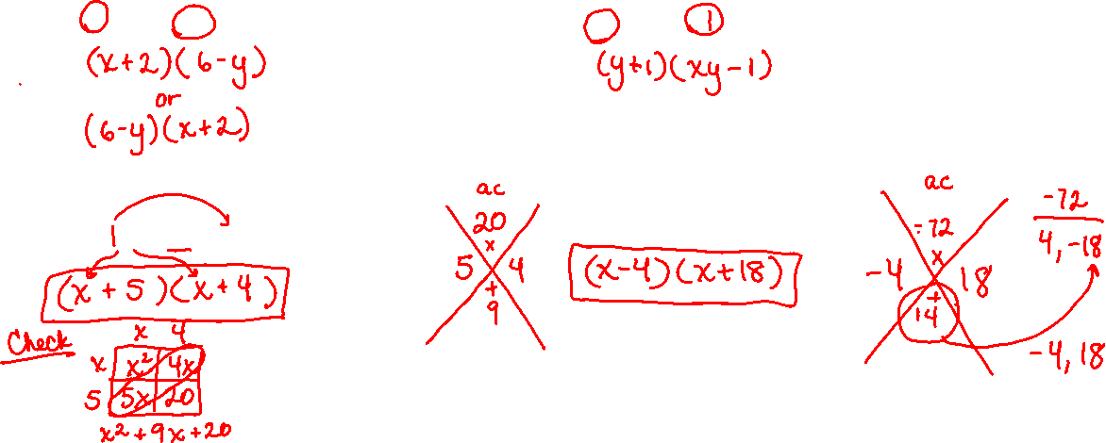

Lesson 4-4 Part 1 Notes
Examples
2. (We do) Factor out the GCF.
a. $6\left(x+2\right)−y(x+2)$ b. $xy\left(y+1\right)−\left(y+1\right)$
3. (We do) Factor each expression (a = 1).
a. $x^{2}+9x+20$ b. $x^{2}+14x−72$

Slide 13
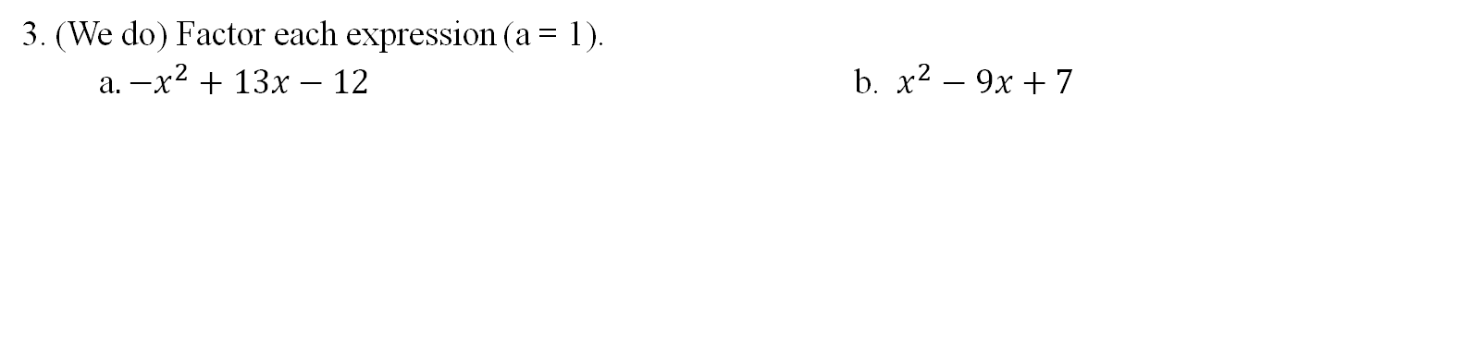
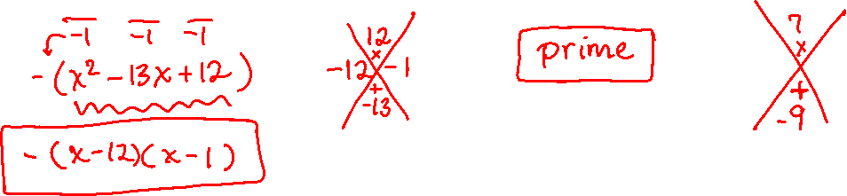
Lesson 4-4 Notes
Examples
3. (We do) Factor each expression (a = 1).
a$. −x^{2}+13x−12$ b. $x^{2}−9x+7$

Slide 14
Independent Practice/Lesson Check 4-4

Slide 15
Independent Practice/Lesson Check 4-4

Slide 16
4-4 Part 2 Factoring Quadratic Expressions
Standards Objectives
A2.A.REI.B.3 Solve quadratic equations and inequalities in one variable. Solve quadratic equations by inspection (e.g., for $x^{2}$= 49), taking square roots, completing the square, knowing and applying the quadratic formula, and factoring, as appropriate to the initial form of the equation. Recognize when the quadratic formula gives complex solutions and write them as a ± bi for real numbers a and b.
SWBAT extract common and binomial factors when given quadratic expressions IOT factor quadratic expressions.

Slide 17
4-4 Factoring Quadratic Expressions
Objective
Having an $x^{2}$ term and no higher exponent
Take out
SWBAT extract common and binomial factors when given quadratic expressions IOT factor quadratic expressions.
Rewrite the expression as a product (using multiplication).
Having 2 terms
(prefix-bi)

Slide 18
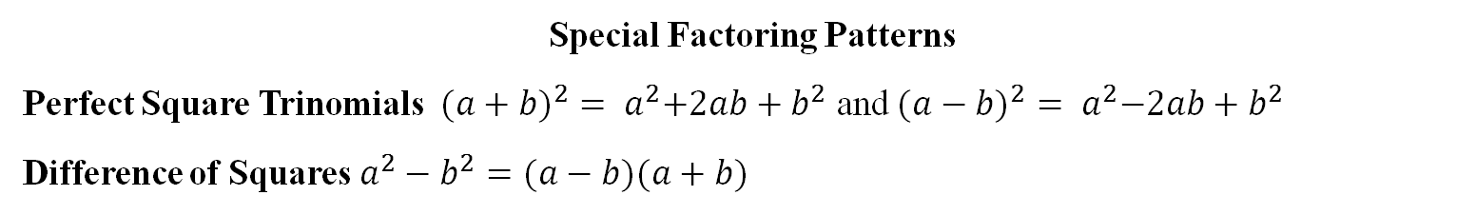
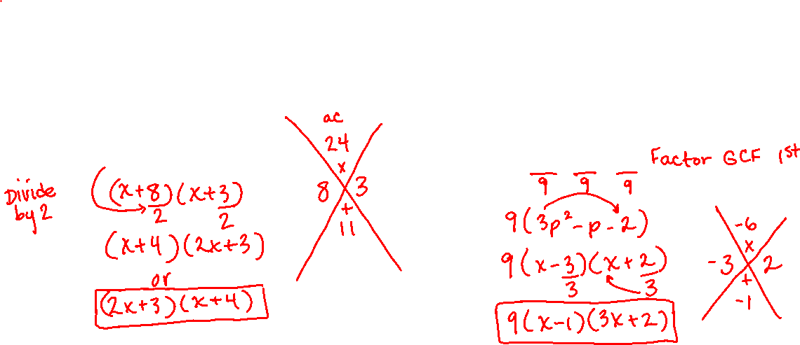
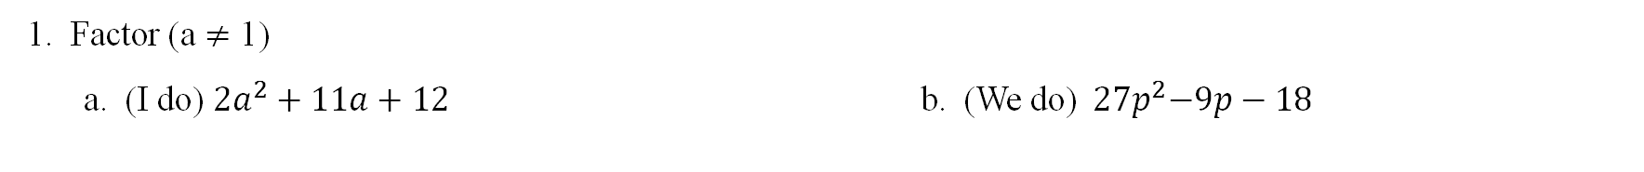
4-4 Factoring Quadratic Expressions
Key Concepts
Special Factoring Patterns
Perfect Square Trinomials ${ ({a+b)}^{2}= a}^{2}+2ab+b^{2}$ and ${({a−b)}^{2}= a}^{2}−2ab+b^{2}$
Difference of Squares $a^{2}−b^{2}=(a−b)(a+b)$
Examples
1. Factor (a $≠$ 1)
a. (I do) $2a^{2}+11a+12$ b. (We do)${ 27p}^{2}−9p−18$

Slide 19
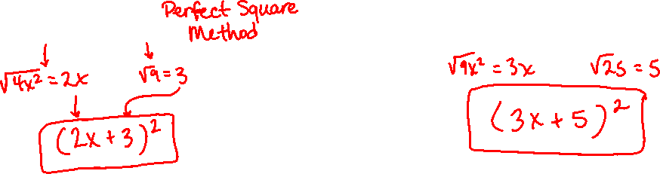
Lesson 4-4 Part 2 Notes
Examples
2. Factor the perfect squares
  ( I do ) $4x^{2}+12x+9$ b. (We do) $9x^{2}+30x+25$

Slide 20
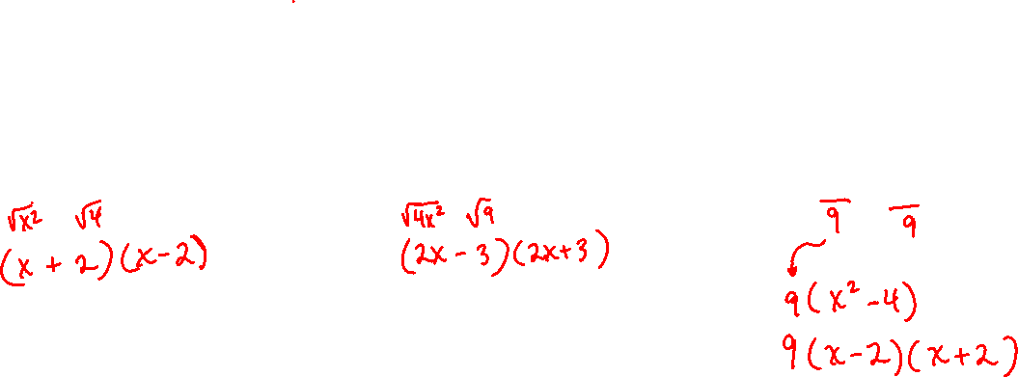
Lesson 4-4 Part 2 Notes
Examples
3. (I do) Factor using the difference of squares
a. $x^{2}−4$ b. $4x^{2}−9$ c. $9x^{2}−36$

Slide 21
Independent Practice/Lesson Check 4-4 Part 2

Slide 22
Independent Practice/Lesson Check 4-4 Part 2

